Slide 1
CSE3020 - Data Visualization
Dr. K.P. Vijayakumar, VIT Chennai

Slide 2
Plots in Data Visualization
ggplot()
"gg" in "ggplot" stands for "the grammar of graphics"
Syntax
ggplot(dataset, aes(xaxis, yaxis)) + geom_something() + geom_somethingElse()
aes -> aesthetic
geom_something() + geom_somethingElse() - > Layers
Source: kaggle

Slide 3
Plots in Data Visualization
Three layers
geom_point() - scatter plot
geom_line() - line chart
geom_bar() - bar chart/Pie
geom_histogram - histogram
Set up
library(tidyverse) - includes ggplot2

Slide 4
Plots in Data Visualization
Scatter Plot - geom_point()
Ex:
library(tidyverse)
df=read.csv("HRDataset_v14.csv")
ggplot(df)
ggplot(df, aes(x= EmpID, y= Salary)) + geom_point()
Source: kaggle

Slide 5
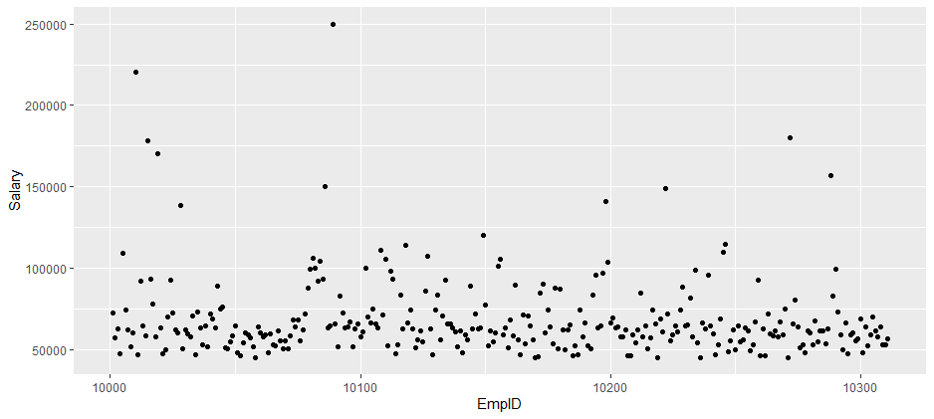
Plots in Data Visualization
Scatter Plot - geom_point()

Slide 6
Plots in Data Visualization
Line chart - geom_line
Example
library(tidyverse)
df=read.csv("HRDataset_v14.csv")
ggplot(df, aes(x= EmpID, y= Salary)) + geom_line()

Slide 7
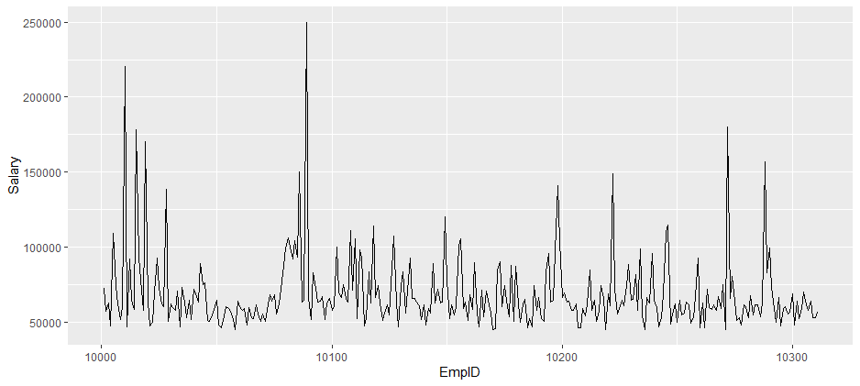
Plots in Data Visualization
Line chart - geom_line

Slide 8
Plots in Data Visualization
Bar Chart - geom_bar()
Example
library(tidyverse)
df=read.csv("HRDataset_v14.csv")
ggplot(df, aes(x= MarriedID)) + geom_bar()

Slide 9
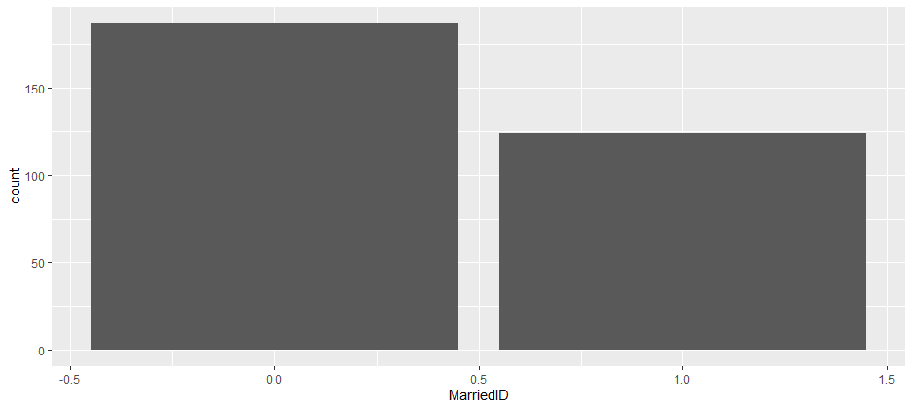
Plots in Data Visualization
Bar Chart - geom_bar()

Slide 10
Plots in Data Visualization
Bar Chart - geom_bar()
Example
library(tidyverse)
df=read.csv("HRDataset_v14.csv")
ggplot(df, aes(x= RecruitmentSource)) + geom_bar()

Slide 11
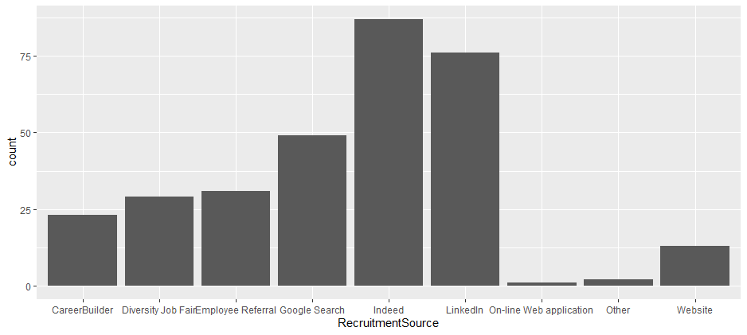
Plots in Data Visualization
Bar Chart - geom_bar()

Slide 12
Plots in Data Visualization
Bar Chart - geom_bar() -
Example
library(tidyverse)
df=read.csv("HRDataset_v14.csv")
ggplot(df)
ggplot(df, aes(x= MaritalDesc)) + geom_bar()

Slide 13
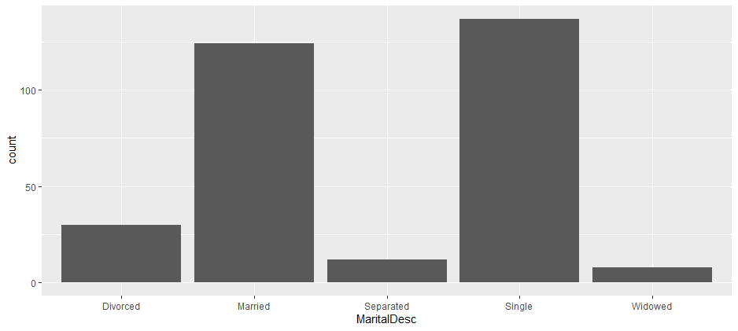
Plots in Data Visualization
Bar Chart - geom_bar()

Slide 14
Plots in Data Visualization
Bar Chart - geom_bar() -
Example
library(tidyverse)
df=read.csv("HRDataset_v14.csv")
ggplot(df, aes(x= MaritalDesc, fill=MaritalDesc)) + geom_bar()

Slide 15
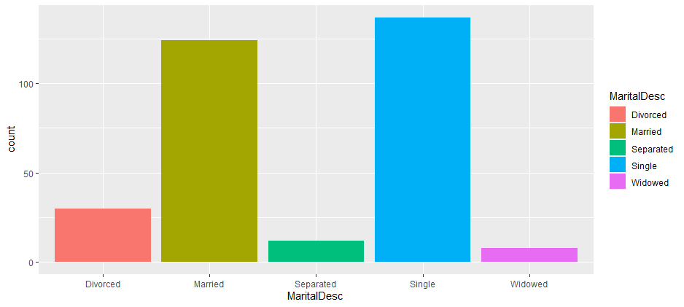
Plots in Data Visualization
Bar Chart - geom_bar()

Slide 16
Plots in Data Visualization
Bar Chart - geom_bar() -
Example
library(tidyverse)
df=read.csv("HRDataset_v14.csv")
ggplot(df, aes(x= MaritalDesc, fill=MaritalDesc)) + geom_bar()

Slide 17
Plots in Data Visualization
Bar Chart - geom_bar()

Slide 18
Plots in Data Visualization
Bar Chart - geom_bar() -
Example
library(tidyverse)
df=read.csv("HRDataset_v14.csv")
ggplot(df, aes(x= MaritalDesc)) + geom_bar()+ coord_flip() #bar plot - horizontal

Slide 19
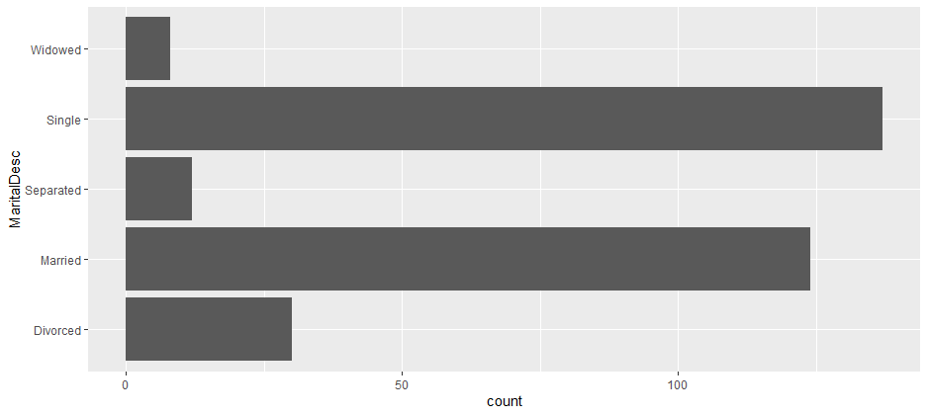
Plots in Data Visualization
Bar Chart

Slide 20
Plots in Data Visualization
Scatter Plot - geom_point()
Ex:
library(tidyverse)
df=read.csv("HRDataset_v14.csv")
ggplot(df, aes(x= EmpID, y= Salary)) + geom_point()+geom_smooth(method = "lm")
Source: kaggle

Slide 21
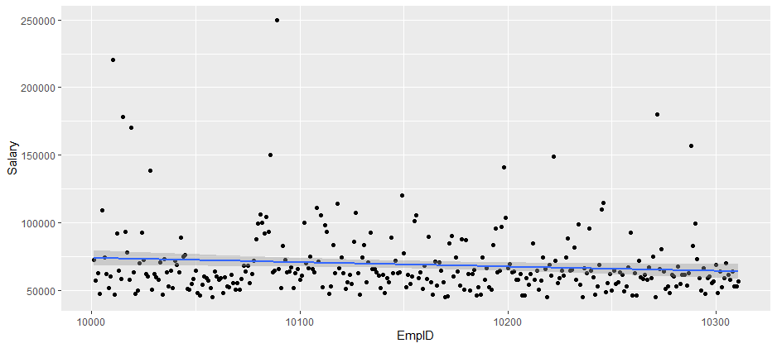
Plots in Data Visualization
Scatter Plot - geom_point() + geom_smooth(method = "lm")

Slide 22
Plots in Data Visualization
Pie Chart - geom_bar()+ coord_polar(theta = "y") + scale_x_discrete("")
Ex:
library(tidyverse)
df=read.csv("HRDataset_v14.csv")
ggplot(df, aes(x = factor(""), fill = MaritalDescID))+ geom_bar()+
coord_polar(theta = "y") +
scale_x_discrete("")
Source: kaggle

Slide 23
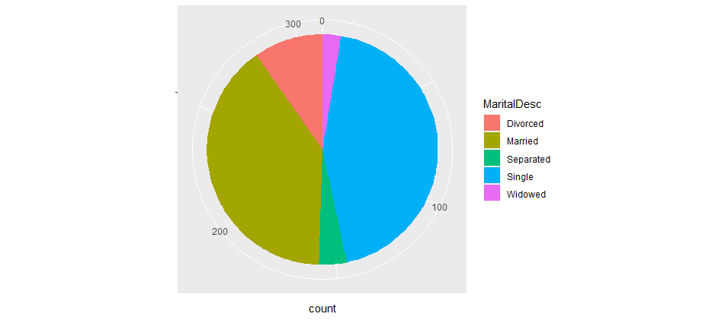
Plots in Data Visualization
Pie Chart- geom_point() + geom_smooth(method = "lm")

Slide 24
Plots in Data Visualization
Histogram- geom_histogram
Ex:
library(tidyverse)
df=read.csv("HRDataset_v14.csv")
ggplot(df, aes(EngagementSurvey) ) + geom_histogram(color="white")
Source: kaggle

Slide 25
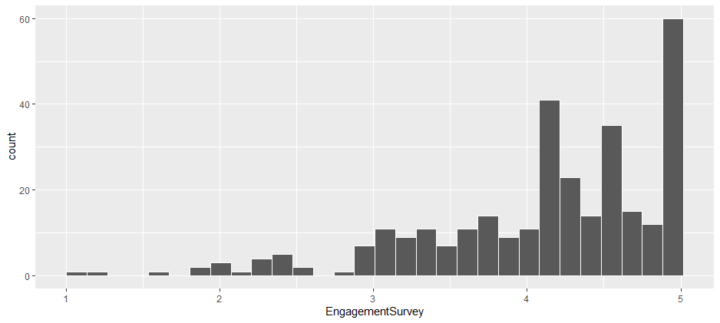
Plots in Data Visualization
Histogram

Slide 26
Plots in Data Visualization
Histogram- geom_histogram
Ex:
library(tidyverse)
df=read.csv("HRDataset_v14.csv")
ggplot(df, aes(EngagementSurvey) ) + geom_histogram(color=“green")
Source: kaggle

Slide 27
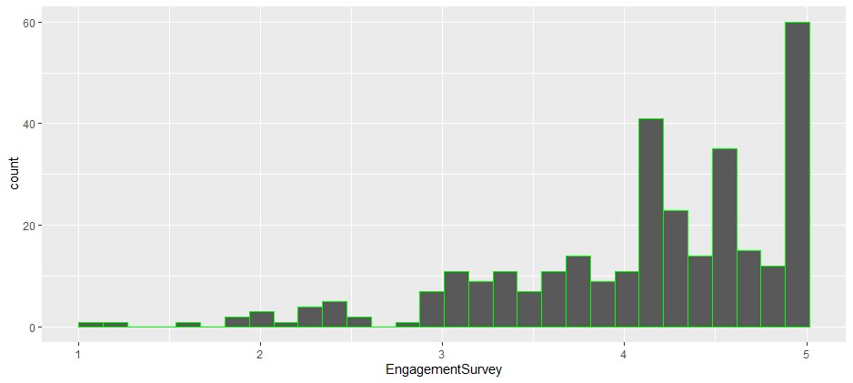
Plots in Data Visualization
Histogram

Slide 28
Plots in Data Visualization
Histogram- geom_histogram
Ex:
library(tidyverse)
df=read.csv("HRDataset_v14.csv")
ggplot(df, aes(EngagementSurvey) ) + geom_histogram(color=“red”,binwidth=0.5)
Source: kaggle

Slide 29
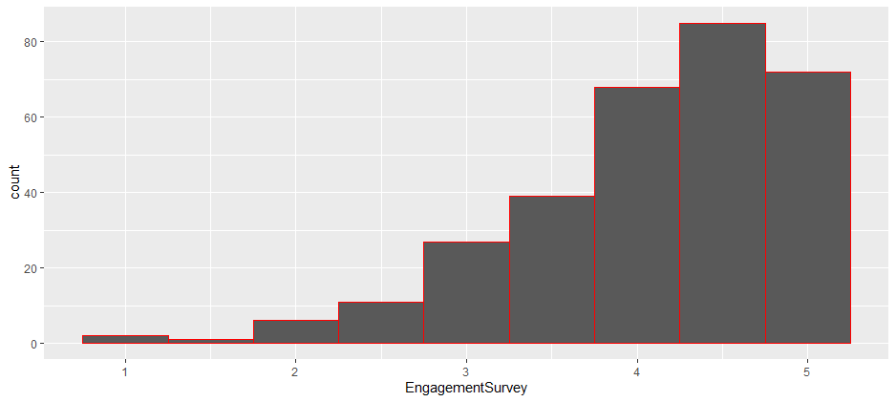
Plots in Data Visualization
Histogram

Slide 30
Plots in Data Visualization
Histogram- geom_histogram
Ex:
library(tidyverse)
df=read.csv("HRDataset_v14.csv")
ggplot(df, aes(EngagementSurvey) ) + geom_histogram(color=“red”,binwidth=0.5)
Source: kaggle

Slide 31
Plots in Data Visualization
Histogram

Slide 32
Plots in Data Visualization
Density - geom_density()
Ex:
library(tidyverse)
df=read.csv("HRDataset_v14.csv")
ggplot(df, aes(EngagementSurvey) ) + geom_density()
Source: kaggle

Slide 33
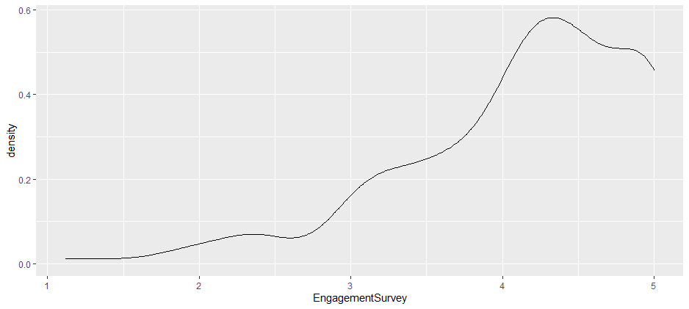
Plots in Data Visualization
Histogram

Slide 34
Plots in Data Visualization
Histogram + Density
Ex:
library(tidyverse)
df=read.csv("HRDataset_v14.csv")
ggplot(df, aes(EngagementSurvey) ) +
geom_histogram(color="red",binwidth = 0.2, aes(EngagementSurvey, ..density..))+ geom_density()
Source: kaggle

Slide 35
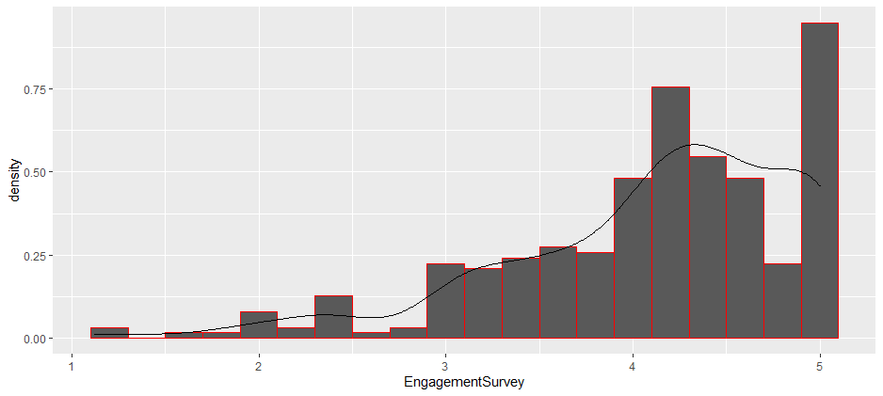
Plots in Data Visualization
Histogram + Density

